Slide 1


National Youth Service
Phase II
03 August 2023 10am
Bidder Briefing Session

Slide 2

APPOINTMENT OF 10 NON-PROFIT ORGANISATIONS TO MANAGE THE NATIONAL YOUTH SERVICE PHASE 2 FOR A PROGRAMME OF THE PRESIDENTIAL YOUTH EMPLOYMENT INTERVENTION
FOR THE PERIOD OF 12 MONTHS AND A POSSIBLE EXTENSION OF 2 PERIOD OF 12 MONTHS EACH
RFP2023/20/NYDA

Slide 3
AGENDA
1
TERMS OF REFERENCE
OBJECTIVES, CONDITIONS AND REQUIREMENTS OF THE TENDER PROCEDURE
2
3
THREE (3) STAGE EVALUATION PROCESS
4
EXTERNAL BID SUPPORT
5
QUESTIONS

Slide 4





1. Terms of reference
1.1 Application Timeline
21 July
3 Aug.
7 Aug.
11 Aug.
30 Aug.
Sept.
Sept.
1 Oct.
10h00
16h00
16h00
11h00
RFP release date
Compulsory Briefing Session
Written questions of clarification – closing date
Written response to all clarifications
Closing date
*Anticipated Completion of bid evaluations
*Anticipated letter of Award
Commencement Date

Slide 5
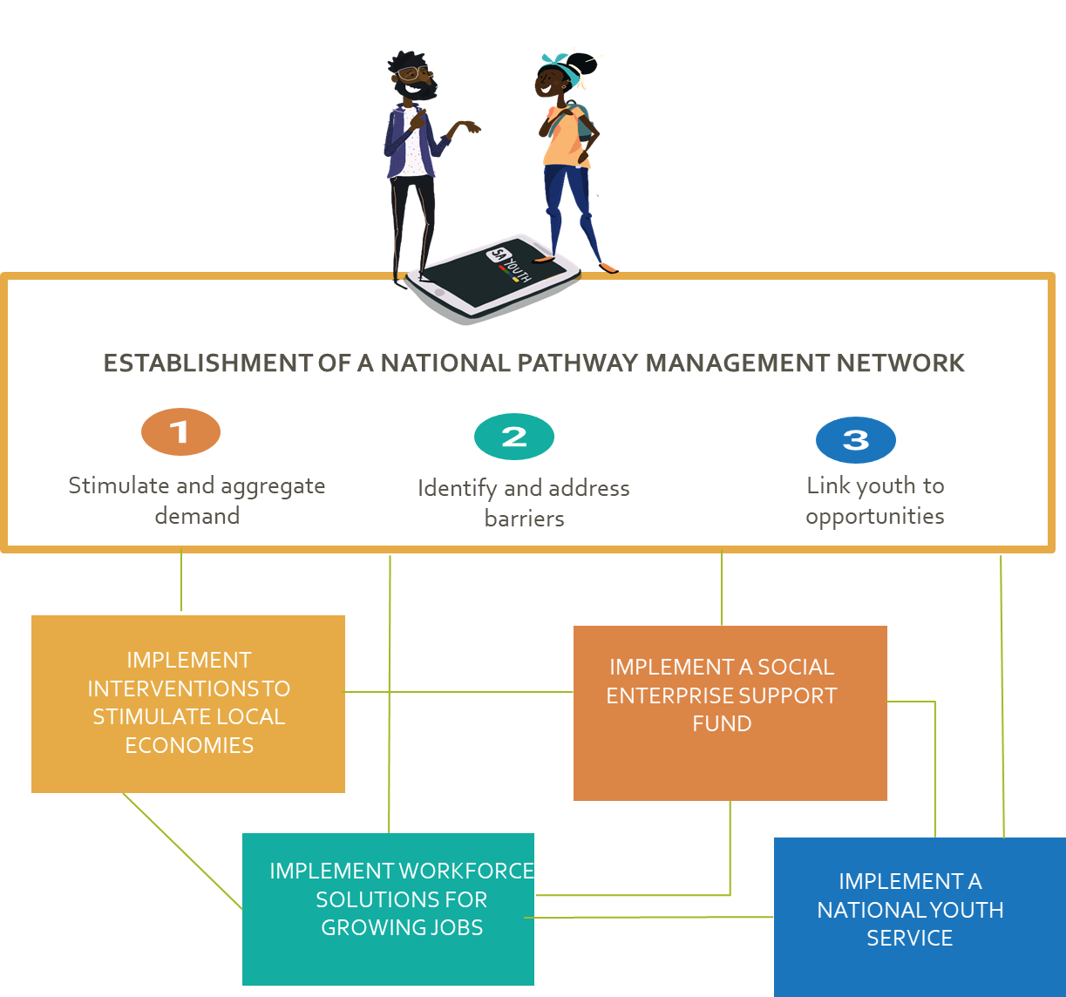
Terms of reference Continues
1.2 Introduction PES, PYEI
The Presidential Youth Employment Intervention (PYEI) is a part of the Presidential Employment Stimulus (PES).
The PYEI is a multi-sector action plan/ programme directed at addressing South Africa’s chronic youth unemployment challenge.
The PYEI has identified several priority interventions to accelerate youth pathways into the economy over the next five years including:
  The establishment of a National Pathway Management Network,
  Delivery of agile workforce development,
  Support for youth self-employment and enterprise in the township and rural economy,
  The strengthening of workplace experience, and
  The revitalised National Youth Service programme.

Slide 6
1.3 Introduction – Institutional Arrangements
The Presidency is the co-ordinating Department for the Presidential Employment Stimulus (PES) and the Presidential Youth Employment Intervention (PYEI).
The Department of Women, Youth and Persons with Disabilities (DWYPD) is the Executive Authority of the NYDA and has oversight over the Agency and the program.
  The Department will ensure that the program design is in accordance with the National Youth Service Coordinating Framework,
  The Department will ensure reporting to the Youth Sector through the National Youth Coordinating Forum.
A National Youth Service Working Group will be established by the DWYPD and the NYDA which will include all Government Departments already implementing youth service.
The NYDA is the Accounting Authority for the program and will ensure full accountability and reporting for the program including incorporating into the Five Year Strategic Plan and the Annual Performance Plan.
The Presidency, DWYPD, Department of Employment and Labour, and NYDA have initiated a Presidential Youth Employment Fund as a ring fenced grant fund to exclusively finance components of the PYEI.
The National Youth Development Agency (NYDA) invites proposals from non-profit making entities that can participate in the delivery of the National Youth Service programme.

Slide 7
1.4. Overview-Revitalised National Youth Service
Why do we need a National Service programme?
There is a vast array of diverse young people ready and yearning to serve their country. Youth service plays a role in civic responsibility, in developing a common identity, recovery and rehabilitation and nation building.
This is a passionate and idealistic generation that sees the emergency, wants to serve those around them.
There is a wealth of work for them to do in public schools reigniting forgotten after school programs, in tackling societal issues such as alcohol and substance abuse and GBV and in building social solidarity in their communities.
There is also an opportunity to crowd in private sector and civil society investment in a broader social compact around service.
The number of young people wanting to participate on service programs almost always exceeds the available slots.
We would want to encourage in each new generation the habits of work, the taste for adventure, and a sense of duty.
Broad outline
The program aims to recruit at a minimum of 20 000 participants on a structured 6-month program working 16 hours per week with stipends paid at the National Minimum Wage.
Should additional funding be secured over the MTEF, we will extend the program to twelve months.
A series of implementation agents will be appointed through this Call for Proposal (a competitive bidding window) to support the recruitment of participants, the establishment of work sites, the site administration, the training of young people and the transition and pathways of young people.
The aim of this second CFP is to encourage collaboration and partnerships.

Slide 8
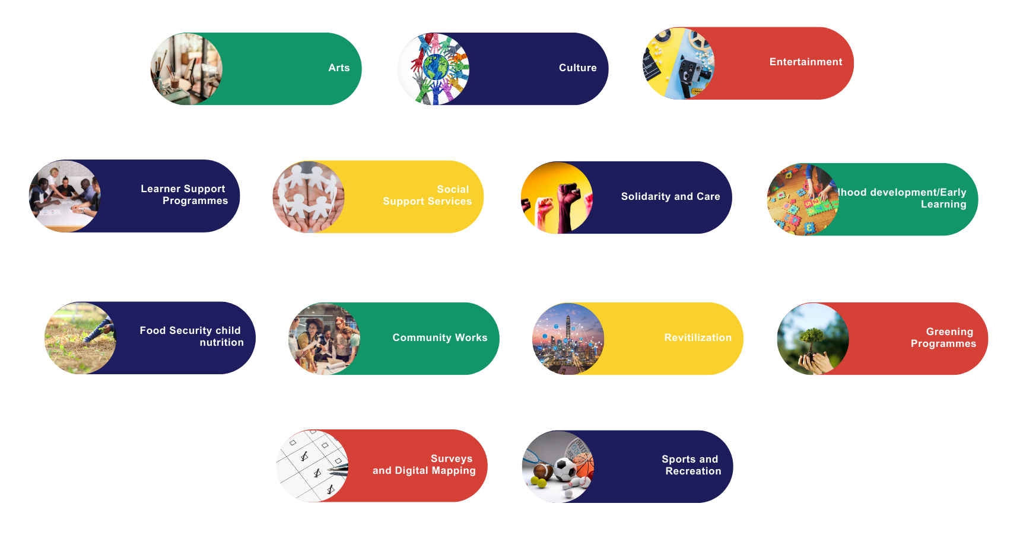
1.5 Community- Service Sectors

Slide 9
1.6 Requirements (1)
Lead Applicants
Must demonstrate own capacity to engage 2,000 youth in Community Service activities or the ability to crowd in and manage a consortium of entities which can successfully assist in meeting the youth target per year.
Must be a Non-profit Organisation as defined by the Non-profit Organisations Act 71 of 1997 (the NPO Act); or a Non-Profit Companies (NPCs) as defined in Schedule 1 of the Companies Act.
Must have been registered with the relevant department (e.g. Department of Social Development) for at least 2 years. All requisite certificates and proof of registration will be required.
Must be in full compliance with administrative requirements (including Tax Compliance Status);
Must have audited or reviewed Annual Financial Statements (AFS) covering at least 3 years.
Must demonstrate capacity and robust operating systems to pay stipends to 2,000 youth. Such systems, including those to manage a monthly payroll (including UIF issues) at the scale proposed for the NYS will be assessed during the Due Diligence stage of the application process.
Lead Applicants/ Implementing partners
Must have a track record of more than three years of technical experience in the area of interest.
Must provide their programme content (this and all other information will be managed confidentially and will only be used for assessment of the application).

Slide 10
1.6 Requirements (2)
Collaborations
Applicants are encouraged to collaborate and partner with other organisations. These collaborations and partnerships could be with:
NPOs/ NPCs – NPOs/NPCs contracting directly with the NYDA to engage 2,000 young people through their own operations.
Consortiums – An NPO/NPC contracting directly with the NYDA to engage 2,000 young people by crowding in and managing a consortium of implementing partners.
Private sector organizations – Private companies may partner with the lead NPOs/NPCs and provide additional resources (financial or in-kind) and opportunities for NYS participants to transition into.
In the case of a consortium, applications must elaborate on the consortium composition, which must be logical and value-adding. Roles and responsibilities of consortium members must be clearly defined. In addition, the applicant/ consortium lead must demonstrate an alignment of incentives and a “common purpose” across members of the consortium members.

Slide 11
1.7 Funding Criteria
Applications for the Presidential Youth in Service programme are to be costed on a fairly standard model. For each applicant, the budget should be categorised into the following:
Stipend cost for youth service participants: Costing should be based on the assumptions that each participant will earn at the hourly rate of R23.19 and 16 hours per week. It is envisaged that team leaders will be allocated on a ratio of one team leader for every 25-young people participating in the program. Team leaders will earn at 125% of the hourly prescribed rate.
UIF and bank charges: Budgets must also include a maximum allowance of 3% of the stipend costs to cover employer UIF contributions and bank charges.
Service Implementation Costs up to 17.5% maximum must include:
Project Management 7.5%
Tools of Trade 5%
Skills Development & Training 5%
Operational Costs:
Participant Uniforms & PPE 5%
Devices 0.7%
Evaluation and close out costs, capped at 0.8% of the stipend costs:

Slide 12
1.8 NYS Principles
Alignment with NYS programme principles & link to other PYEI programmes: (1) Applications must demonstrate how their vision/purpose/strategy is aligned with the principles, and purpose of National Youth Service as outlined in Section 3 of the term sheet. Preferred initiatives are those that propose innovative ways of linking NYS programme beneficiaries to other PYEI programmes. (2) Applicants must be able to successfully enrol all programme beneficiaries onto the Pathway Management Network platform.
Scale: Applications must demonstrate how the initiative will achieve scale in terms of expanding geographical footprint, partnering with more organisations, and (or) working with more young people. Initiatives must outline the key activities that will be undertaken to achieve this outcome.
Contribution to Systemic Change: Applications that contribute to broader impact in the lives of participating youth, generate learning beyond the confines of their specific initiative and positive change at community are preferred. (1) Applicants must show how sustainable Community Service activities, can potentially build the basis for more sustained and complex social economy interventions in an area and (2) Demonstrate how young people who have shown aptitude and competence in the NYS programme will be assisted to find further contracted/ paid work or be assisted to grow. (3) Lastly, applicants must show how the initiative will support young people to build agency, resilience and grit – which are critical success factors for young people on their employment/income journey; explain what young people will be able to do at the end of the programme that they may not have been able to do prior to involvement.
Capacity to Implement: Applicants must demonstrate relevant experience, and organisational capacity. (1) Applicants must show an appreciation of the project’s specific local context and determinants of success and how these will be put in place, (2) Consortium composition must be logical and value adding, & roles and responsibilities clear., (3) Applicants must demonstrate capacity to pay and administer monthly stipends e.t.c
NPO Capacity Building
Demonstrate your organisation’s experience in working with multiple stakeholders, local Communities and Community-Based Organisations in the past.
Demonstrate your organisation’s experience in building the capacity of stakeholders, local Communities, and Community-Based Organisations in the past
Demonstrate how your organisation will support [financially, technically, and through skills transfer] local Communities and Community-Based Organisations for participating in the proposed initiative.

Slide 13



1.9 Implementation Timeline
Two (2) months inception phase: recruitment of young people into the programme, successful on-boarding of participants on SA Youth.mobi, setting up of service sites/ partnerships and development of Individual Service Plans for each young person outlining the planned service work for the 6 months.
Seven (7) months service implementation phase: monitoring and tracking of the cohort through their 6 months service work period, regularly report to the NPMN and NYDA. Implementers are expected to consistently engage partners to ensure NYS participants transition to other opportunities upon their graduation.
Three (3) months close-out phase i.e., project evaluation and close-out audit.
Post-implementation reporting: Implementors will be required to report on specific outcomes achieved after the term of the contract but attributable to the project.

Slide 14
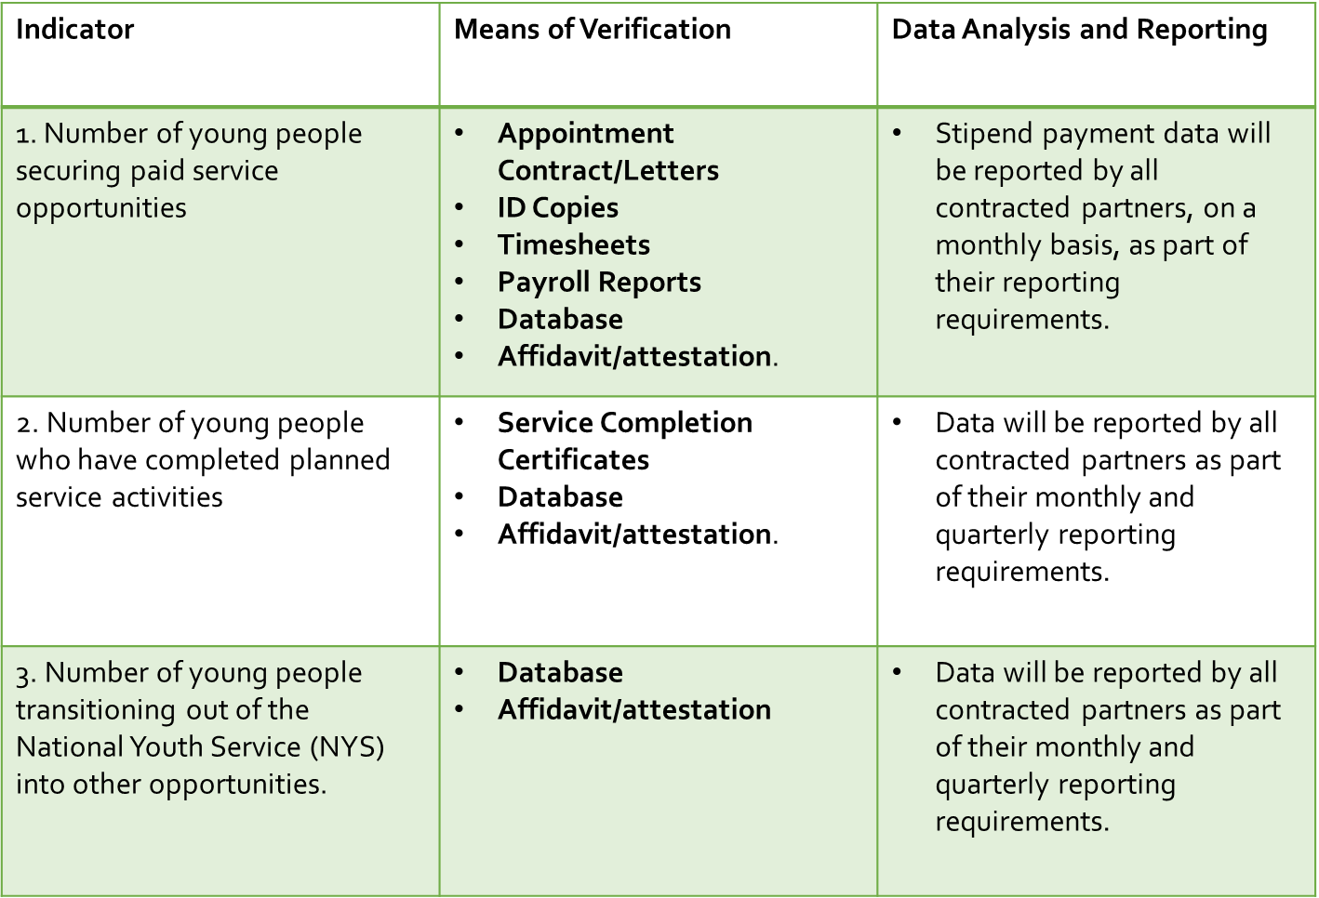
1.10 Performance Indicators

Slide 15
1.11 Payments
Key principles
Applicants must have ring-fenced project bank accounts.
Beneficiaries (young people) must be registered and validated via SA Youth.Mobi
Beneficiaries must have validated bank accounts.
Payments are performance based except initial advance payments.
Payment Process
The NYDA will pay Intermediaries initial advance for site admin/ operational costs & stipends after contracting.
The NYDA will pay site admin/ ops. costs to Intermediary quarterly, in advance based on achievements & validation of expenditure evidence [performance targets, Tier 1 evidence].
The NYDA will pay stipend costs via Intermediary monthly, in advance based on submission of validated proof of work done [timesheets, attendance records. etc].
The Intermediary will pay beneficiaries on receipt of funds from the NYDA.
Stipends are to be paid on set payment dates.

Slide 16
2. Objectives, Conditions And Requirements of the Tender Procedure
All participating bidders must indicate their company name and company representative in Teams chat with contact details (email & number)
Bidders are reminded: Telephonic request for clarification will not be accepted. Any clarification required by a bidder regarding the meaning and interpretation of the Terms of Reference or any aspect concerning the bid must be requested in writing via email from SCM (tenders@nyda.gov.za).
Written questions of clarification must be sent on or before the 7th of August 2023 at 16h00
A reply to all questions and answers is intended to be sent by email to all prospective bidders as follows:
Tuesday: 11th of August 2023
The bid number (RFP2023/20/NYDA) should always be quoted in all correspondence.

Slide 17
2. Objectives, Conditions And Requirements Of The Tender Procedure (continued)
A submission of one original hardcopy version must be the original submission, clearly marked "Original" and a softcopy/electronic version in PDF-Format digital copied versions of the original (Flash-drive/USB/Memory Stick)
The original and a copy must contain the same information and must be clearly marked and professionally presented.
Bids should be submitted in a sealed envelope, marked with:
Bid number: RFP2023/20/NYDA
Bid Description: APPOINTMENT OF 10 NON-PROFIT ORGANISATIONS TO MANAGE THE NATIONAL
YOUTH SERVICE PHASE 2 FOR A PROGRAMME OF THE PRESIDENTIAL YOUTH EMPLOYMENT
INTERVENTION FOR THE PERIOD OF 12 MONTHS AND A POSSIBLE EXTENSION OF 2 PERIOD OF
12 MONTHS EACH. RFP2023/20/NYDA
The name and address of the bidder
Bids must be submitted on or before 11h00, on Thursday, 30th of August 2023.
Bids which are submitted after the closing date and time will not be accepted.
Bidder’s representative are encouraged to share the information with the person who will be compiling the bid document to ensure that the requirements of the tender are understood.

Slide 18
3. Stage Evaluation Process
Mandatory criteria (Stage One)
During the administrative/eligibility assessment, failure to provide any mandatory information as requested on page 9 will result in the proposal being deemed non–responsive.
Functionality criteria (Stage Two)
(i) Experience of the organisation in managing a development programme of more than 500 participants. The programmes should have included:
• Four or more contactable references 20 points
• Three contactable references 15 points
• Two contactable references 10 points
• One or no contactable references 0 points
(ii) Experience of the project Manager or Technical Teams 10 Points
as per outlined criteria in the Tender document.
Working with smaller NGOs
Maximum Provision of positive reference letters or agreements with other partners as per tender document 20 points
Provision of proof that the bidder has access to Youth Database of at least 2000 young people 15 points
Capacity to implement 35 points
NB: Bidders who fail to obtain a minimum threshold on functionality of 70% will be disqualified from Further Evaluation

Slide 19
3. Three (3) Stage evaluation process continued
Stage Three – Price and Special Goals
Price instruction
Completion of pricing schedule provided on page 22
Specific goals as outlined on SBD 6.1 page 35
Price instruction
Bidder must price according to the price schedule provided.
A breakdown of costs should be provided, where necessary.
All prices quoted will remain firm for twelve (12) months after the contract has been awarded.
Pricing should include VAT if applicable and must be in South African Rand.
Prices tendered must be valid for 120 days.
Pricing schedule must be filled and signed in blank ink, no re-typed or re-produced document
will be permitted.
NB: Bidders must comply with the price instruction as indicated on page 21

Slide 20

4. Support to organisations developing proposals for the NYS
On behalf of the German Federal Ministry of Economic Cooperation and Development (BMZ), the Deutsche Gesellschaft für Internationale Zusammenarbeit (GIZ) aims to support organisations that intend to submit an application for the NYS in developing their proposals

Slide 21

4.1 What is being offered?
GIZ has contracted DEZ Advisory Services (DEZ) to provide you with support in developing a powerful proposal for the NYS.
The experts can support you with the following:
1
2
3
IDEATION:
COMPLIANCE:
PROPOSAL DEVELOPMENT:
Developing project ideas that align with the aims of the NYS
Reviewing whether your organisation fulfils the minimum eligibility criteria and guiding you to make sure you submit all the right documents
Completing a compelling proposal that highlights the strengths of your organisation
(Please note: your organisation will be responsible for bearing any cost associated with complying with the necessary requirements)

Slide 22
4.2 When you use this support, it does not mean you get funding for your organization.
Making use of the support does not imply any preferential treatment in the selection of the NYS recipients, and there is no funding associated in any way with making use of the support.
Neither GIZ nor DEZ are involved in the selection of NYS recipients.

Slide 23
Do I have to make use of the support?
No.
The offer of support is voluntary and completely independent of the NYS selection process.
Who is the support for?
Anyone!
The support is for any entity that has a winning idea and meets NYS’s funding criteria.
How much does the support cost?
Nothing.
There are no financial contributions required.
GIZ is providing this limited offer free of charge to the applicants.

Slide 24
4.3 How do I access the support?
Send an email to S2PYEI@giz.de with the subject “NYS proposal support”.
Include in the email:
Name of your organisation
A short description of your intended project (1-2 sentences)
A short description of the support you require
Requests must be sent by 7 AUGUST 2023 in order to qualify for the support.
Support will be provided on a first-come-first-serve basis.

Slide 25
5. Questions, Clarity or Comments

Slide 26


THANK YOU
The National Youth Development Agency
Website: www.nyda.gov.za
Send all bid enquiries to:
tenders@nyda.gov.za

